Slide 1
The Santa Fe Alliance for Science Adopt-a-School
STEM Explorers! -
Online Program (pilot)
Notes:
How do we sign up?

Slide 2
Vision
For the students participating:
Introduce new, diverse STEM topics.
Walk through the scientific process with short, simple examples.
Inspire students to investigate topics that are interesting to them.
What is the goal of this online program?

Slide 3
How are students motivated?
Participation incentives programs have positive effects on improving engagement.
They also increase perceived motivation across age and gender.
Points-based system, due-date flexibility, prizes/awards are the top three main motivators in a gamified environment.

Slide 4
STEM Explorers Pilot:

Slide 5
Pilot program
Each video has an amount of activities worth a certain amount of points:
Reading (2 points)
Examples (3 points)
Activities (5 points)
Projects or Alternative Option (10 points)
A Volunteer from the SFAFS:
Introduces the pilot program to all students (rules, prizes, etc).
The Adopt-a-School Team is available to answer questions via Zoom.
"Comes back” at the start of the week, ask questions about how it went, etc.
If there are questions for teachers, we provide an Educator’s Guide to our video catalogue.
Videos are produced with STEM subjects, that encourage students (4th, 5th grade) to learn and practice new topics that might interest them.
Videos contain topics explained by volunteer scientists and engineers.
Topics will include:
Math
Statistics
Computer science
Health science
And more!

Slide 6
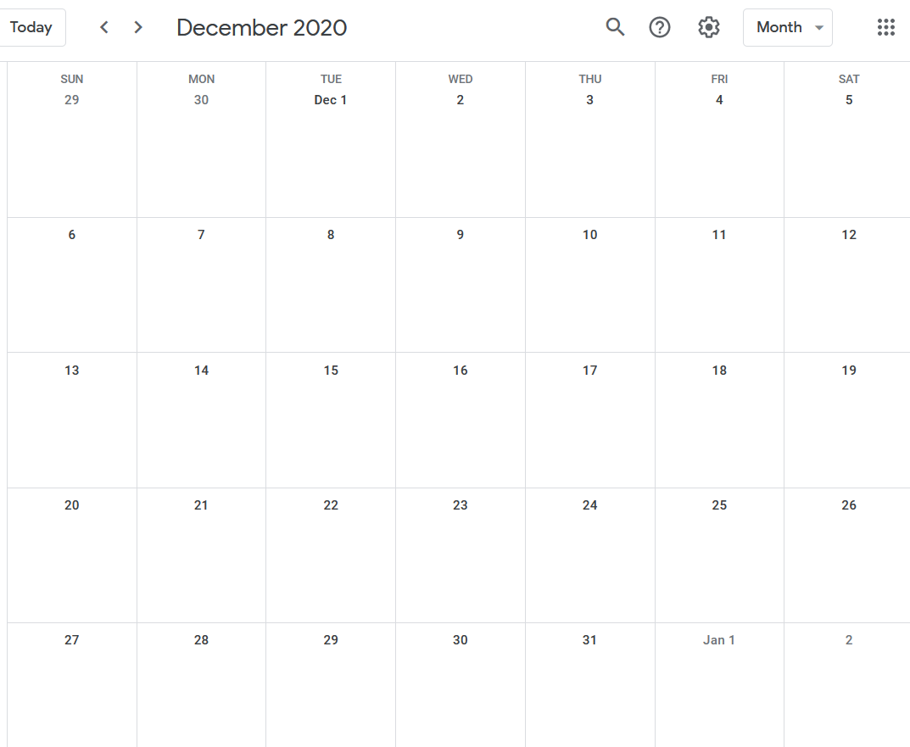
When does it take place?
Prizes:
Amazon gift card:
$50, $30, $20 for students.
$100 and $50 for teachers.
Winning student (1) has most points or first to reach all points possible.
Next place: 1st place in other classes (?).
Finally, 7 next students with most points (independent of teacher).
Students from other 4th, 5th grade classes can participate without formal teacher participation (good word-of-mouth).
Winning teacher (1) heading class with winning student.
Runner-up teachers (?).
Teachers sign-up via email
info@sfafs.org
Notes:
At the end of the season, a prize will be awarded to:
The 3 students with the most points (or the first 3 that reach all possible points.
The classroom (all students) with the most points at the end of the season (or the first classroom that reaches the total number of points).

Slide 7
Video Timeline

Slide 8
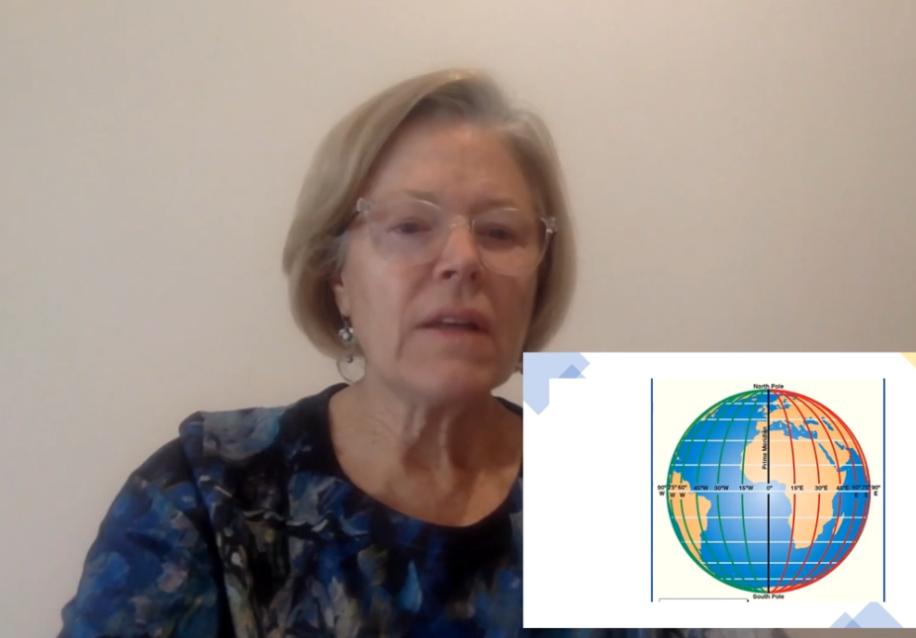
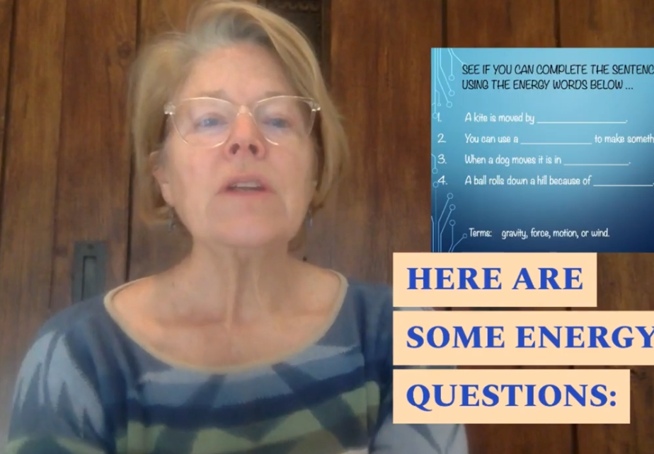
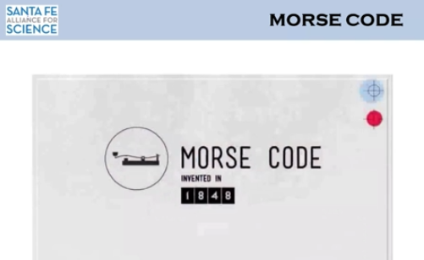
Week 1 - Released November 30th, 35 points
3
2
5
5
10
10
Examples Video: Secrets in Code 1
Reading Video: Earth and Mapping 1
Activity Video: Humane Ed: Tour 1. What are they guided by? (3 things in the video) 2. How many adoptions happen? (over 90%) 3. How many pets did they return last year? (over 1000) 4. How many other shelter centers do they have? (3) 5. Can volunteers walk dogs?
Activity Video: Energy 1 Stuff: Energy in your house
Project Video: Energy 1 Stuff: toy car, smooth surface, book or 2, a tape measure, ruler.
Project Video: How do craters form? Stuff: box, rocks, sand, ruler.

Slide 9
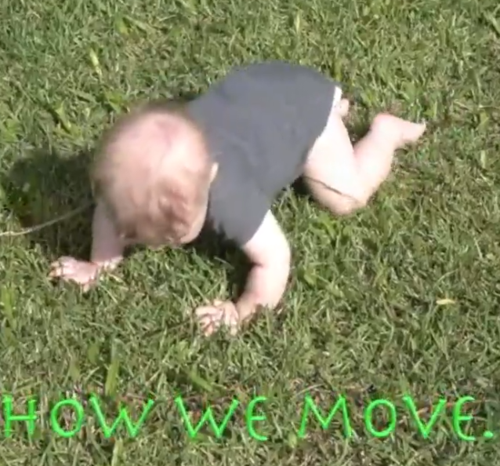
Week 2 - Released December 7th, 26 points
3
3
5
5
10
Examples Video: Secrets in Code 2
Examples Video: Secrets in Code Ex Morse Code “wash your hands now”, robot example, blinking example
Activity Video: How we move 1 Please: One hand in, one hand out (video?)
Activity
Video: Math ratios 1 Try these ratios (6 examples)
Project Video: Math ratios 1 Hummingbird feeder: soda bottle, straw, hammer, nail, glue, wire, string
Activity Stuff: What words did we learn?
Activity Stuff: Do that dancing step for 10s.

Slide 10
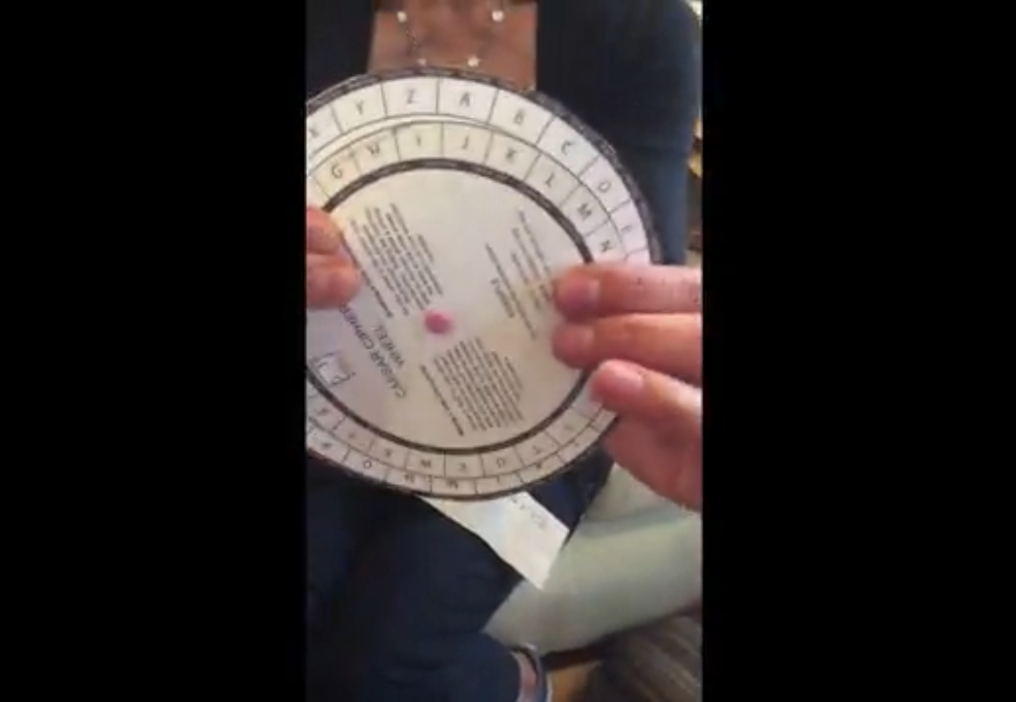
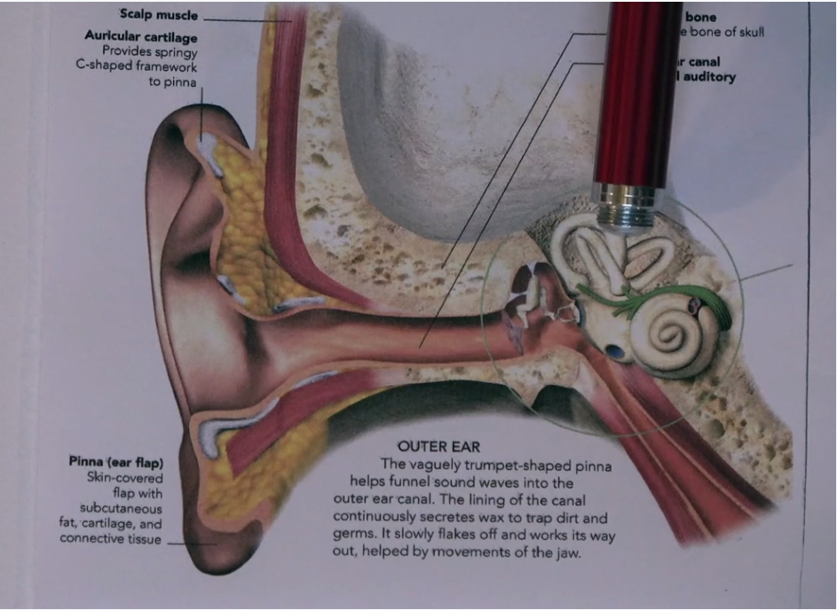
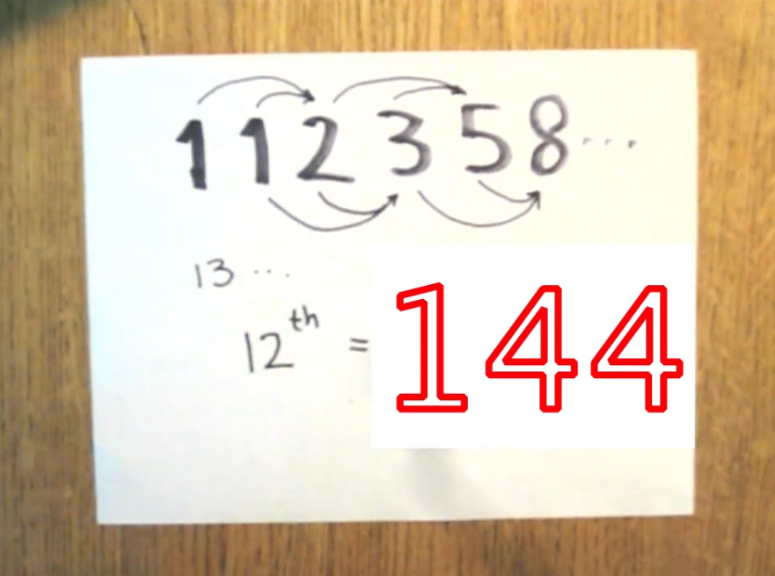
Week 3 - Released December 14th, 38 points
3
10
5
5
5
10
Examples Video: Secrets in Code 3
Project Video: Secrets in Code Ex DIY Cipher Wheel Stuff: Scissors, paper bag, ruler, marker, paper clip
Activity Video: How we move 2 Please: What words did we learn?
Survey
Activity Video: Fibonacci numbers - Golden ratio (graph paper, ruler, pen)
Project Video: Fibonacci numbers - Measure ratios things around the house (newspaper, books, etc)
Activity Please: balancing act

Slide 11
What do we need from teachers?
30-45 minutes for introduction/conclusion.
Make parents aware of this pilot.
Project is self-motivating but a nudge here and there is appreciated.

Slide 12
Questions? SFPS Community Resources: https://tinyurl.com/y2eg725a

